Slide 1

Helping Kids With High Abilities Soar
Presented by:
Sherry Finnerty, MS. Ed
Based on the book, Helping Gifted Children Soar by Carol Strip Whitney Ph.D . with Gretchen Hirsch

Slide 2
Characteristics of High Ability:
Children learn to read early, with better comprehension of the nuances of language-many know how to read before entering school
They read widely, quickly, intensely and have large vocabularies
Common basic skills are often learned better, more quickly with less practice
Children can better construct and handle abstractions
They often pick up and interpret nonverbal cues and can draw inferences that
other children may need spelled out for them
They take less for granted and seek the “hows” and “whys”
They sometimes can work independently and concentrate for longer periods
Their interests have a wide range and they are intently focused
High energy
They usually respond and relate well to others especially those who are older
They tackle tasks and problems in a well-organized, goal-directed manner
There is an intrinsic motivation to learn, find out, or explore and are often
very perisistent. “I’d rather do it myself” is a common attitude.

Slide 3
Learning Characteristics
Keen powers of observation and an eye for important details
Read alot on their own
Find great pleasure in intellectual activity
Well-developed powers of abstraction, conceptualization and synthesis
Readily see cause/effect relationships *****
They display a questioning attitude and seek information for its own sake as much as for its usefulness
They can be skeptical, critical and evaluative. They are quick to spot inconsistencies
They often have a large storehouse of information about a variety of topics, which they can recall quickly.
They readily grasp underlying principles and can often make valid generalizations about events, people, or objects.
They quickly perceive similarities, differences, and anomalies.
They often attack complicated material by separating it into components and analyzing it systematically

Slide 4
Creative Characteristics
Fluent thinkers, able to generate possibilities, consequences and related ideas
Flexible thinkers-able to use many different approaches and alternatives to problem solving
Original thinkers who seek new, unusual or unconventional associations and combinations among items of information
See relationships among seemingly unrelated objects, ideas or facts
Elaborate thinkers-they produce new steps, ideas, responses, or other embellishments to a basic idea, situation or problem
They are willing to entertain complexity and seem to thrive on problem solving
Good guessers and readily construct hypothesis and “what if” questions
They are aware of their own impulsiveness, irrationality and show intense emotional sensitivity
Extreme curiosity about objects, ideas, situations or events
Playful-like to fantasize and use imagination
Express opinions more freely and may disagree more spiritedly with others
Sensitive to beauty and attracted to aesthetic values

Slide 5
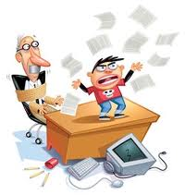
“The truly creative mind in any field is no more than this:
A human creature born abnormally, inhumanly sensitive.
To him….
A touch is a blow,
a sound is a noise,
a misfortune is a tragedy,
a joy is an ecstasy,
a friend is a lover,
a lover is a God,
and failure is death.
Add to this the cruelly delicate organism the overpowering necessity to create, create, create----so that without the creating of music or poetry or books or buildings or something of meaning, his very breadth is cut off from him. He must create, must pour out creation. By some strange, unknown, inward urgency he is not really alive unless he is creating.” -Pearl Buck

Slide 7
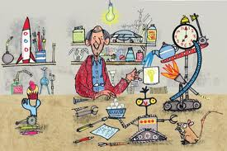
Helping High Ability Kids Learn
The ideal classroom is a place where teacher’s open children’s minds to the magic and charm of the world around them. Students learn through their eyes, ears, hands, mouths and noses. They learn through music, art, nature, technology, textbooks, experiments, study trips, etc. They learn in groups-project –based learning and also independently. Students learn best when they feel connected to their
teacher, other students and learning.

Slide 8
Differentiation- 4 ways
Differentiation means providing learning options that meet the needs of our high ability students.
Teachers can modify the content of the curriculum so that students are matched with activities based on their particular academic strengths.
Teachers may match instructional style to child’s preferred learning style.
Group students
Teachers may vary products students create-oral report, essay, diorama of lesson, etc.

Slide 9
Ideas for Enrichment
Curriculum compacting/telescoping: Students may test out of curriculum and use their time on an assignment that has more depth and complexity on a subject of interest to them.
Learning contracts: Very effective. This helps the child set limits because often the child wants to learn everything at once and may abandon a project as soon as something more fascinating pops up on their radar screen.

Slide 10
Tic Tac Toe Menus
Write a brief diary as a plantation slave trying to escape slavery. | Find 3 recordings of 3 songs that were sung in the time of slavery. Tell the class about the overt and hidden meanings of these songs | Write a comparison of the biographies of Sojourner Truth and Harriet Tubman.
Did any early Presidents of the United States own slaves? If so, list which Presidents. | FREE SPACE | Trace the underground Railroad on a map. How extensive was it? How many different branches did it have? How long, on average, did it take to reach freedom? Write answers on map.
Write an alternative ending to any of the books from this unit. | Write a review of two movies that have slavery as a theme. Contrast the movies’ attitudes about slavery . | Choose another student to debate with you on the issue of slavery. Each of you will prepare a list of points to support your side.

Slide 11
Teachers require students to complete a diagonal, horizontal or vertical row and perhaps everyone gets to complete the “free space” which allows a student to create their own activity or idea to explore.
Cubing- Teachers plan different types of activities for students based on their interests, learning styles or other factors. Teachers create six-sided cubes that include a different task on each face. Students roll the cube to see what they get. Example: Teacher writes who, what, when, where, how, why on each side of the cube to review literature on a history lesson. A teacher could write dates on cube and have students research what happened on those dates. Teachers may use two dice and write nouns on one and verbs on the other and the student makes up sentences using both. A teacher might have characters on one cube and settings on another. Students write a short story based on what they rolled.

Slide 12
Bloom’s Taxonomy
Remembering
Understanding
Applying
Analyzing
Evaluating
Creating
Cubes sides might be: Recall, Explain, Connect, Examine, Consider, Create

Slide 13


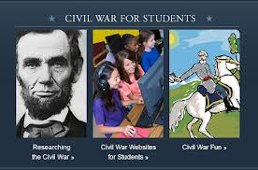
Cubing
1. Recall facts: Who were Grant and Lee? What side did each command? Who won the conflict? (Remembering)
Explain: What characteristics did Grant and Lee have in common? How were they different from one another? (Understanding)
Connect: Did Grant and Lee have anything to teach today’s military leaders? Explain. (Applying)
Examine: Compare how Grant and Lee felt about slavery. Did their beliefs coincide with their actions? (Analyzing)
Consider: In your opinion, which general do you believe was more admirable. Defend your point of view (Evaluating)
Create: Write a brief scene in which Grant and Lee are having a conversation about their experiences during the Civil War. (Creating)

Slide 14
How Can Parents Help
Provide the teacher with information regarding your child’s interests and passions
Provide extra-curricular activities and enrichments
Provide an accepting, trusting, non-judgmental environment
Don’t expect perfectionism or for your child to excel in ALL areas all the time-gifted children may have average abilities in some areas and also could have disabilities as well
Praise hardwork and effort-not achievement
Recognize and understand the social-emotional aspects of having high abilities and help your child manage emotions

Slide 15
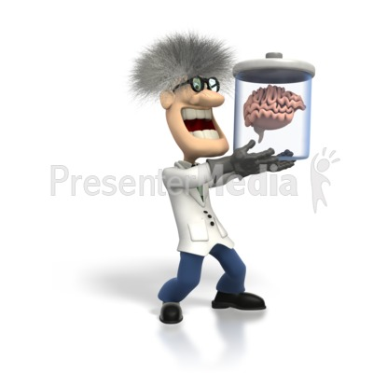
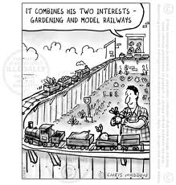
Support the Child’s Interest
Whether you understand, like or appreciate what your child is passionate about doesn’t matter. Show support by attending performances, fairs, competitions, shows, etc. You can also help your child advance his/her area of passion by helping him/her spend time with others who share similar interest. Help build a network of adults who can help with internships, sponsors, career advice and job offers.
Praise the Child for effort NOT results and stay away from words such as best, the smartest, brilliant. (Go over study done)
Avoid put-downs
Send I messages and not You messages
Help your Child build Social Skills through play dates,
books, role-playing, conversations, movies
Laugh with your child-don’t forget to play and be playful
Don’t expect high abilities in ALL areas
Be an advocate for your child. Join support groups,
email lists, newsletters, etc. Attend workshops.

Slide 16
10 Commandments of Trust
1. Give the child focused attention: Look at the child and get down to their level.
“Can you explain what you need quickly or should reserve a time to talk this evening?”
2. Take issues seriously
3. Make sure your body language matches your words and tone….they have truth sensors and a need to call you out!
“Yes, I am angry b/c I asked you to move your science project and it is still there”
Respect privacy unless there is a reason for concern
Insist the child respects your limits and other people’s too.
Set limits and enforce consequences when rules are broken. The child may need to share their opinions and also may need you to share your rationale for imposing a limit.
Teach all feelings even uncomfortable ones like anger or resentment are ok, but acting them out by being rude, disrespectful, unkind or abusive is not.

Slide 17

It’s hard to wait isn’t it but lucky for us we will get to practice the lifeskill of patience right now.
6. BE PREPARED TO EXPLAIN REASONS FOR RULES AND LIMITS
Setting limits most likely will result in lively debate. Children with High Ability can think up more ways to object than a room full of prominent lawyers! Idle threats are unproductive and I said so will rarely work. Put in rules and limits you will enforce.
Don’t be afraid to say YES:
“Yes it is ok if you make the 3 level castle”
“Yes you can paint a mural and put it on your wall”
“Yes you can write a play and perform it for the family after supper”
Kids with high abilities want to do things that are creative, expands knowledge and tests limits.

Slide 18
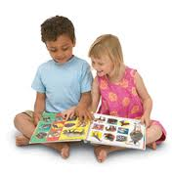
Respect child’s confidences unless something has to do with another’s safety or health.
Include child in some decision making. Ask, “What do you think would be fair” or “What ideas do you have for this?”
Tell the Truth but only give details/information appropriate to child’ s age and level of sophication.
HA kids can seem to be bundles of raw nerves
All Children Experience: | HA experience is:
Stress | More
Depression | Deeper
Perfectionism | More intense
Friendship Issues | More Painful Loneliness
Self-esteem Issues | Lower
Lack of motivation | Greater when not interested

Slide 19

Accepting Children with High Abilities
Accepting children who challenge, interrupt, argue and sometimes outshine you can be exhausting!
Challenging behaviors may include: being overly emotional, intense perfectionism, intolerance of others, disorganized and sloppy, constant questioning and debating, talking, talking, talking, talking, talking, talking,talking,talking

Slide 20
Emotional Intensity-INTENSE REACTIONS
Negative Reactions
Explosive outbursts
Crying jags
Paralyzing anxiety
Fear
Positive Reactions
Giddiness
Highly frenetic energy
Laughter
General happiness/Elation
Overexcitability
Mood Swings
Physical Responses-headaches, stomachaches, nausea, heart palpitations, blushing, sensory sensitivity to tags, socks, etc.
Strong Affective Memory-remember not just events but feelings associated with event. They relive feelings of significant moments in their lives over and over again. Strong attachments to people and things coupled with this memory may make transitions very difficult.

Slide 21

Helping Your Child
High Ability children need to learn how to -manage their time
- stay on track
- finish what they start
- take responsibility for their actions
Discipline and Punishment are not the same thing. Discipline and disciple have the same Latin root meaning-pupil or learner
Help your child learn
principles and values by
modeling expected behaviors
Remember …students with high abilities have a keen sense of observation and will mimmick what they see the people they love and admire do.
If you speak rudely, they will too.
If you are judgmental, they most likely will be.
If you help others, they will become more compassionate and empathetic.

Slide 22
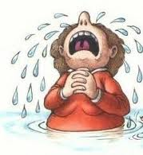
Power of Words
Encourage enthusiasm, curiosity and originality. Do not deflate it.
Harsh words really break their spirits.
HA kids often need to work through their thoughts and ideas out loud which requires a lot of talking and possibly repeating the same scenario over. Open ended responses are very helpful:
“Oh really, why do you think that happened?”
“How do you feel about that?”

Slide 23
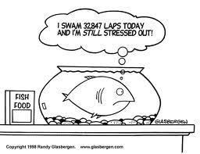
Stress
Master Challenges
Meet Goals and Deadlines
Behave Responsibly
Causes:
Changes
Expectations are too high
Concern for the world-considerable global awareness, worry about war/disease, starving children, earthquakes, violations of civil rights-they know they have special talents and feel they must use them to solve the world’s problems now
Overly intense parent-Reading for many hours is not as effective as reading for a while then attending community events or visiting museums, festivals, children’s theatre, etc.
Disconnected parents-Allow the child to raise him/herself

Slide 24

Stress
Too many activities scheduled
Lack of fit
Boredom
Needless rigidity (clock on wall activity)
Loneliness
WHAT DOES STRESS LOOK LIKE?
Hyperactivity
Clingy
Bored and Unmotivated
Crying
Appetite/Sleeping Changes
Eye-Blinking
Sullen/Withdrawn
Constant Worrying
Bed Wetting
Not wanting to go to school
Anger
Overwhelmed

Slide 25
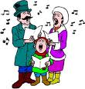
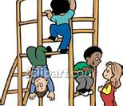
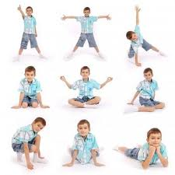


1. Teach Relaxation
2. Teach kids they are human and part of living is making mistakes. Mistakes are for learning and sometimes get us closer to the correct answer!
3. De-stress by engaging in activities such as Yoga, journaling, exercising, counting, Karate, playing a musical instrument, listening to music, going for a walk or running, sing, or dance, take a bath, talk to someone you trust!

Slide 26
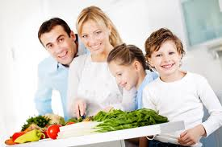
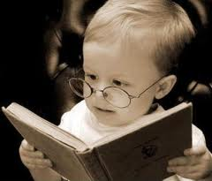
Take up learning something together that is outside the child’s gifted area-join cooking class, auto repair, dance, scouts so you can focus on participation and fun verses ability.
Give child outlets for altruism-consider humanitarian
project such as helping homeless shelter, humane society,
collecting money for charity. Contact faith-based
organizations to find out how to help. Collect items for
domestic violence shelter or school.
Monitor activities. You can have the child keep a calendar and color red for what was stressful, yellow for what he/she enjoyed.
Try Movie Technique

Slide 27


Help your child develop healthy habits with regard to sleeping, eating and exercise
Practice positive self-talk
Work on a child’s perspective, reminding he/she that nothing is ever all good or all bad. Teach your child to be realistic in his/her view of life.
Teach your child that they have a perspective and so do others. Sometimes we have to agree to disagree and accept that others may have a different opinion and everyone is entitled to have one.
Try mental rehearsal or practicing a scenario/task if the anxiety is preventing performance on a specific task.
Visualize Favorite Vacation
Try Focused Deep Breathing/Square Breathing

Slide 28

Depression
Why does a HA child feel depressed?
Children with High Abilities feel deeply and intensely. Feelings can be painful and cause the child to shut down. When they try to shut off the sadness, they shut off all emotions which include joy, happiness, etc.
Children with High Abilities experience unbearable fatigue. They process a lot of information at high speeds all at once.
Perfectionism
Intense anger
Want to right wrongs-overly
developed sense of justice

Slide 29
Signs
Lack of interest in activities
Loss of friends
Eating/Sleep habits change
Become more fidgety or withdrawn
Drop in grades
Loss of energy or restlessness
Inability to concentrate
Thoughts of suicide-If student has plan or is talking about it, then they should be taken to physician or psychiatric facility for evaluation
Stomach/headaches or numerous psychosomatic complaints
Irritability and Sadness
Extreme-Can’t get out of bed, eating disorder or made suicide attempt

Slide 30
What to do for Depression
Seek outside assistance if needed
Understand it is not a choice or weakness
Don’t tell them to snap out of it-would you tell a person in a body cast to run around a table?
Don’t try to reason it out-depression is not reasonable
Use Cognitive Reappraisal
Support the child and encourage them to engage in helping others, joining activities, etc.

Slide 31
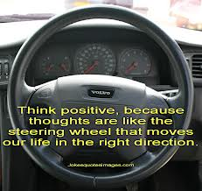
Cognitive Reappraisal
Teach your child that feelings come about
as a result of thoughts they have that they might
not even be aware of. If a child fails a test the
emotional response might be to feel worthless.
The thought behind the emotion might be,
“I must never fail, I am stupid” If you can help the child examine the thoughts that result in he/she having the negative feelings, you can sometimes help the child develop a much healthier attitude. In Free the Horses in 2nd grade, we learn what we think controls how we feel and how we feel controls what we do and what we do affects how we think. The power is in our thinking. Change “Stinkin’ Thinkin’ referred to as Stormy Thoughts to something more positive-Clear-Bright Thinking. (p 217 role play)

Slide 32
Perfectionism
Goes beyond excellence. Perfectionism leaves NO room for error. Outcome MUST be the best! --Sylvia Rimm
Why?
Asynchronous Development: Children go through stages of development much earlier, more intensely and not in the same way. Intellect may be advanced but social/emotional and physical abilities may not be
Messages given by adults in their life that imply they are valued primarily for their achievements
Part of the nature of having high abilities-sensitive children will internalize the concept of less than perfect as being not acceptable

Slide 33
What does Perfection Look Like?
Frustration
Over planning, erasing and redoing projects
Anger-lashing out over insignificant things
Sad –even during fun activities
Stop Trying-masked as underachievement
Nonparticipation-Child may not want to participate if he thinks others may be more accomplished/better at the activity

Slide 34
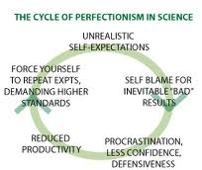
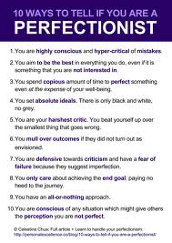
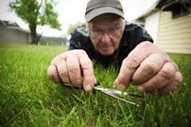

Perfectionist

Slide 35
How to Help Perfectionism
Help your child realize that setting high standards is an admirable quality and striving for excellence is good but at the same time help them understand that not meeting exceptionally high standards is not a reason to get depressed or lose your self worth.
Teach mistakes are for learning and can get you closer to finding the answer through them. Innovators learn from hundreds and thousands of mistakes called trials.
Share stories of times you made mistakes and laugh about them.
Remind kids that most things can’t be done perfectly the first time-give examples of Olympic skaters, dancers, researchers, etc.
Shoot for doing a “darn good job as opposed to perfect”. Even if the project is flawless a true Perfectionist won’t recognize it.
Maintain good health habits
Practice good time management-plot on calendar, divide tasks into steps. Set goals and priorities.

Slide 36
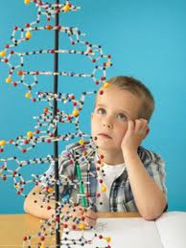

Friendships
Some students exhibit strong leadership and social skills and some students may have difficulty making and maintaining friendships due to having unusual interests, being very intense, having extreme sensitivity, asynchronous development, difficulty reading social cues, difficulty understanding and accepting another person’s point of view. Sometimes “smart kids” are rejected by peers due to
jealousy or uncertainty.

Slide 37
Teaching Social Skills
Books
Role-Plays
Conversations with others
Play Dates
Social Skills Groups
Teams-Sports, Scouts, 4H, Afterschool Clubs
Videos/DVD’s
Social Stories
You Tubes/Computer Websites

Slide 38
Positive Discipline
1. What is your current method of discipline?
Keeping in mind your current discipline strategy, answer the following questions:
Will this teach my child better decision-making skills?
a. Does the discipline change the misbehavior?
b. Does this reduce the need for more discipline?
c. Are you angry when you discipline your children?
d. Are you impulsive with regard to discipline?
4. What is your goal with regard to discipline?
Remember to:
Set appropriate boundaries and clear expectations (household inventory)
Provide predictable reactions from parents

Slide 39
How to Coach Your Child
Effective Communication:
Understand your child’s needs and wants
Clearly express your needs and wants
Actively listen to your child
Look at nonverbal and verbal communication
Deal effectively with roadblocks to communication
Effective Facilitation:
Teach your child to recognize, understand, and redirect emotionally intense feelings and behaviors.
Utilize modeling and prompting strategies to help children learn.
Focus should be on teaching children how to think, not what to think.
Be a Source of Inspiration:
Walk with your child through this growth process –Christine Fonseca

Slide 40
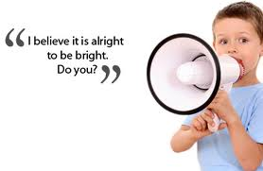
Celebrate Their Gifts
Having a true
understanding of
what a person with
high abilities truly
experiences will help
you support them
and lead them down
the road to success!

